Slide 1
ICT703 Programming
Module 3 Topic 1
Iteration

Slide 2
Objectives
Introduce Iteration
Write a loop to repeat a sequence of actions a fixed number of times
Write a loop to traverse the sequence of characters in a string
Write a loop that counts down and a loop that counts up
Write an entry-controlled loop that halts when a condition becomes false

Slide 3
Programming Concepts
Four control flow
Sequence
Iteration
Selection
Abstraction – methods/classes
- Plus Data

Slide 4
Iteration
Doing things many times
Bounded/Definite
Execute commands for a set number of times
Python - for loop
Unbounded/Indefinite
Execute until a condition becomes false
Python while loop

Slide 5
Definitive Iteration: The for Loop
Repetition statements (or loops) repeat an action
Each repetition of action is known as pass or iteration
Two types of loops
Those that repeat action a predefined number of times
Those that perform action until program determines it needs to stop

Slide 6
Executing a Statement a Given Number of Times (1 of 2)
Python’s for loop is the control statement that most easily supports definite iteration
for n in range(2):
print("It’s alive!")
print(“At the moment”)
It’s alive!
At the moment
It’s alive!
At the moment
for eachPass in range(3):
print("It’s alive!")
It’s alive!
It’s alive!
It’s alive!
The form of this type of loop is:
For <variable> in range(<an integer expression>):
<statement-l>
.
<statement-n>
First line of code is sometimes called loop header
Rest of code is loop body (must be indented and aligned in the same column)

Slide 7
What do you think this will return?
It’s alive! 0
It’s alive! 1
It’s alive! 2
It’s alive! 3
for eachPass in range(4):
print("It’s alive!", str(eachPass))
So you will notice that the range starts at 0 and finishes at 3
You need to be aware of this when creating your loops as it can lead to incorrect logic if forgotten

Slide 8
Executing a Statement a Given Number of Times (2 of 2)
Example: Loop to compute an exponentiation for a non-negative exponent
number = 2
exponent = 3
product = 1
for eachPass in range(exponent)
product = product * number
print(product, end = “ ”)
2 4 8
If the exponent were 0, the loop body would not execute and value of product would remain as 1

Slide 9
Count-Controlled Loops (1 of 2)
Loops that count through a range of numbers
product = 1
for count in range (4):
product = product * (count + 1)
print(product)
24
To specify a explicit lower bound:
product = 1
for count in range (1, 5):
product = product * count
print(product)
24

Slide 10
Count-Controlled Loops (2 of 2)
Example: bound-delimited summation
lower = int(input(“Enter the lower bound: ”))
upper = int(input(“Enter the upper bound: ”))
theSum = 0
for number in range(lower, upper + 1):
theSum = theSum + number
print(theSum)
Enter the lower bound: 1
Enter the upper bound: 10
55
What will the result be if we didn’t have the +1?

Slide 11
Loop Errors: Off-by-One Error
Example:
# Count from 1 through 4, we think
for count in range(1,4):
print(count)
1
2
3
Loop actually counts from 1 through 3
Not a syntax error, but rather a logic error

Slide 12
Traversing the Contents of a Data Sequence
We can traverse a list of numbers, things, characters and do “stuff”
for <variable> in <sequence>:
<do something with variable>
list1 = [1, 2, 3, 4]
for list_element in list1:
print(list_element)
for fruit in [“apple”, “orange”, “potato”]:
print(fruit)
for character in “Hi there!”:
print(character, end = “ ”)
H i t h e r e !

Slide 13
Specifying the Steps in the Range
range expects a third argument that allows you specify a step value
theSum = 0
for count in range(2, 11, 2):
theSum = theSum + count
print(theSum)
30

Slide 14
Loops that Count Down
The third argument can be a negative step value
for count in range(10, 0, −1):
print(count, end = " ")
10 9 8 7 6 5 4 3 2 1

Slide 15
Conditional Iteration: The while Loop
The while loop can be used to describe conditional iteration
Example: A program’s input loop that accepts values until user enters a sentinel that terminates the input

Slide 16
The Structure and Behavior of a While Loop (1 of 3)
Conditional iteration requires that condition be tested within loop to determine if it should continue
Called continuation condition
Syntax:
while <condition>:
<sequence of statements>
Improper use may lead to infinite loop
while loop is also called entry-control loop
Condition is tested at top of loop
Statements within loop can execute zero or more times

Slide 17
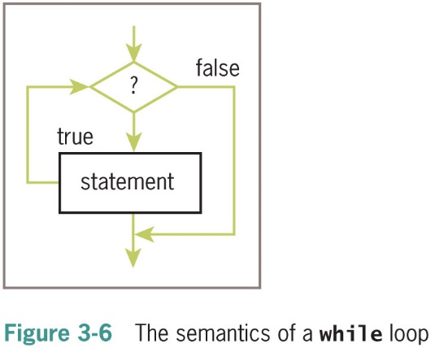
The Structure and Behavior of a While Loop (2 of 3)

Slide 18
The Structure and Behavior of a While Loop (3 of 3)
Example:
theSum = 0.0
data = input(“Enter a number or just enter to quit: ”)
while data != “”:
number = float(data)
theSum = theSum + number
data = input(“Enter a number or just enter to quit: ”)
print(“The sum is”, theSum)
Enter a number or just enter to quit: 3
Enter a number or just enter to quit: 4
Enter a number or just enter to quit: 5
Enter a number or just enter to quit:
The sum is 12.0
Data is the loop control variable
first input statement initializes a variable to a value that the loop condition can test

Slide 19
Count Control with a While Loop
Use a while loop for a count-controlled loop
# Summation with a for loop
theSum = 0
for count in range(1, 100001):
theSum += count
print(theSum)
# Summation with a while loop
theSum = 0
count = 1
while count <= 100000:
theSum += count
count += 1
print(theSum)

Slide 20
Loop Logic, Errors, and Testing
Errors to rule out during testing while loop:
Incorrectly initialized loop control variable
Failure to update this variable correctly within loop
Failure to test it correctly in continuation condition
To halt loop that appears to hang during testing, type Control+c in terminal window or I D L E shell
If loop must run at least once, use a while True loop with delayed examination of termination condition

